Slide 1
Sequential Statements
PUE 3141 Advanced Digital Systems Design

Slide 2
Reference Book
RTL Hardware Design by P. Chu
PUE 3141 Advanced Digital Systems Design

Slide 3
Outline
VHDL process
Sequential signal assignment statement
Variable assignment statement
If statement
Case statement
Simple for loop statement
PUE 3141 Advanced Digital Systems Design

Slide 4
1. VHDL Process
Contains a set of sequential statements to be executed sequentially
The whole process is a concurrent statement
Can be interpreted as a circuit part enclosed inside of a black box
May or may not be able to be mapped to physical hardware
PUE 3141 Advanced Digital Systems Design

Slide 5
Two types of process
  A process with a sensitivity list
  A process with wait statement
PUE 3141 Advanced Digital Systems Design

Slide 6
A process with a sensitivity list
Syntax
  process(sensitivity_list)
  declarations;
  begin
  sequential statement;
  sequential statement;
  . . .
  end process;
PUE 3141 Advanced Digital Systems Design

Slide 7
A process is like a circuit part, which can be
  active (known activated)
  inactive (known as suspended).
A process is activated when a signal in the sensitivity list changes its value
Its statements will be executed sequentially until the end of the process
PUE 3141 Advanced Digital Systems Design

Slide 8
E.g, 3-input and circuit
  signal a,b,c,y: std_logic;
  process(a,b,c)
  begin
  y <= a and b and c;
  end process;
How to interpret this:
  process(a)
  begin
  y <= a and b and c;
  end process;
For a combinational circuit, all input should be included in the sensitivity list
PUE 3141 Advanced Digital Systems Design

Slide 9
A process with wait statement
Process has no sensitivity list
Process continues the execution until a wait statement is reached and then suspended
Forms of wait statement:
  wait on signals;
  wait until boolean_expression;
  wait for time_expression;
PUE 3141 Advanced Digital Systems Design

Slide 10
E.g, 3-input and circuit
  process
  begin
  y <= a and b and c;
  wait on a, b, c;
  end process;
A process can has multiple wait statements
Process with sensitivity list is preferred for synthesis
PUE 3141 Advanced Digital Systems Design

Slide 11
2. Sequential signal assignment statement
Syntax
  signal_name <= value_expression;
Syntax is identical to the simple concurrent signal assignment
Caution:
  Inside a process, a signal can be assigned multiple times, but only the last assignment takes effect
PUE 3141 Advanced Digital Systems Design

Slide 12
E.g.,
  process(a,b,c,d)
  begin -- y_{entry} := y
  y <= a or c; -- y_{exit} := a or c;
  y <= a and b; -- y_{exit} := a and b;
  y <= c and d; -- y_{exit} := c and d;
  end process; -- y <= y_{exit}
It is same as
  process(a,b,c,d)
  begin
  y <= c and d;
  end process;
What happens if the 3 statements are concurrent statements?
PUE 3141 Advanced Digital Systems Design

Slide 13
3. Varible assignment statement
Syntax
  variable_name := value_expression;
Assignment takes effect immediately
No time dimension (i.e., no delay)
Behave like variables in C
Difficult to map to hardware (depending on context)
PUE 3141 Advanced Digital Systems Design

Slide 14
E.g.,
  process(a,b,c)
  variable tmp: std_logic;
  begin
  tmp := '0';
  tmp := tmp or a;
  tmp := tmp or b;
  y <= tmp;
  end process;
PUE 3141 Advanced Digital Systems Design

Slide 15
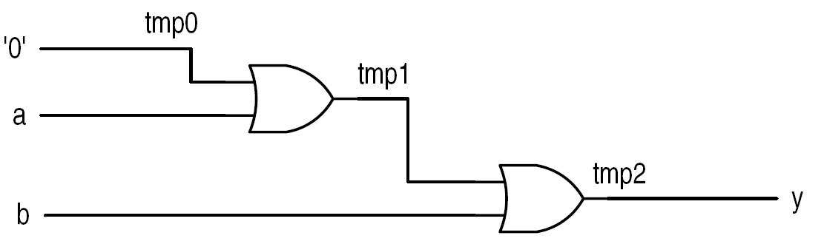
interpretation:
  process(a,b,c)
  variable tmp0, tmp1, tmp2: std_logic;
  begin
  tmp0 := '0';
  tmp1 := tmp0 or a;
  tmp2 := tmp1 or b;
  y <= tmp2;
  end process;
PUE 3141 Advanced Digital Systems Design

Slide 16
What happens if signal is used?
  process(a,b,c,tmp)
  begin -- tmp_{entry} := tmp
  tmp <= '0'; -- tmp_{exit} := ‘0’;
  tmp <= tmp or a; -- tmp_{exit} := tmp_{entry} or a;
  tmp <= tmp or b; -- tmp_{exit} := tmp_{entry} or b;
  end process; -- tmp <= tmp_{exit}
Same as:
  process(a,b,c,tmp)
  begin
  tmp <= tmp or b;
  end process;
PUE 3141 Advanced Digital Systems Design

Slide 17
4. IF statement
Syntax
Examples
Comparison to conditional signal assignment
Incomplete branch and incomplete signal assignment
Conceptual Implementation
PUE 3141 Advanced Digital Systems Design

Slide 18
Syntax
  if boolean_expr_1 then
  sequential_statements;
  elsif boolean_expr_2 then
  sequential_statements;
  elsif boolean_expr_3 then
  sequential_statements;
  . . .
  else
  sequential_statements;
  end if;
PUE 3141 Advanced Digital Systems Design

Slide 19
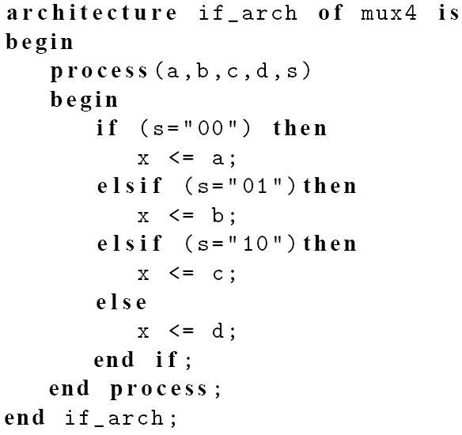
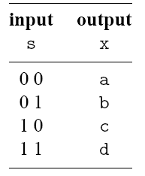
E.g., 4-to-1 mux
PUE 3141 Advanced Digital Systems Design

Slide 20
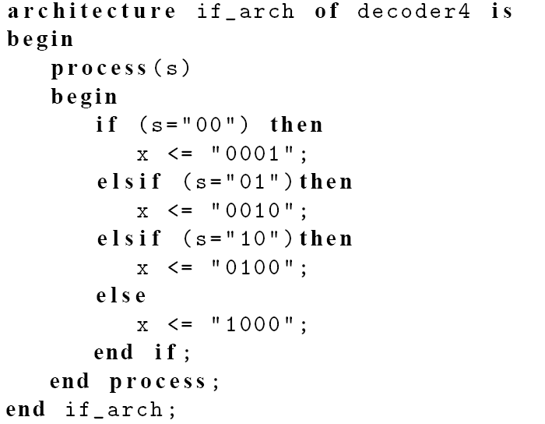
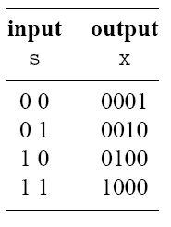
E.g., 2-to-2² binary decoder
PUE 3141 Advanced Digital Systems Design

Slide 21
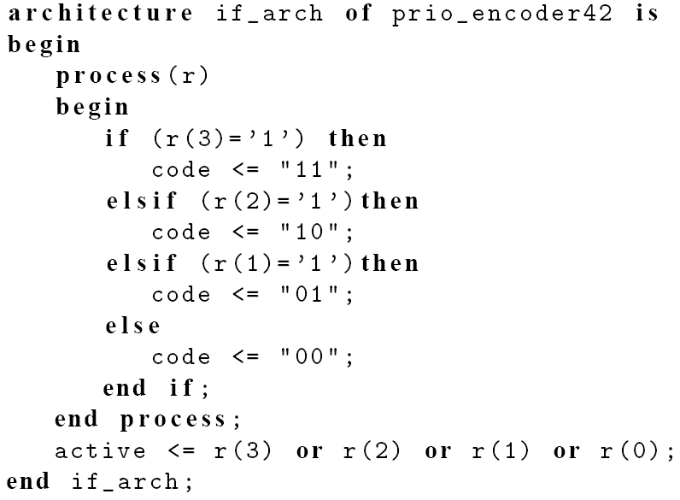
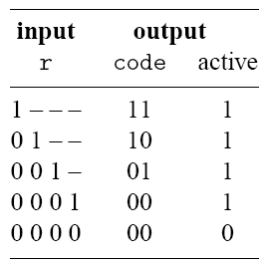
E.g., 4-to-2 priority encoder
PUE 3141 Advanced Digital Systems Design

Slide 22
Comparison to conditional signal assignment
Two statements are the same if there is only one output signal in if statement
If statement is more flexible
Sequential statements can be used in then, elsif and else branches:
  Multiple statements
  Nested if statements
PUE 3141 Advanced Digital Systems Design

Slide 23
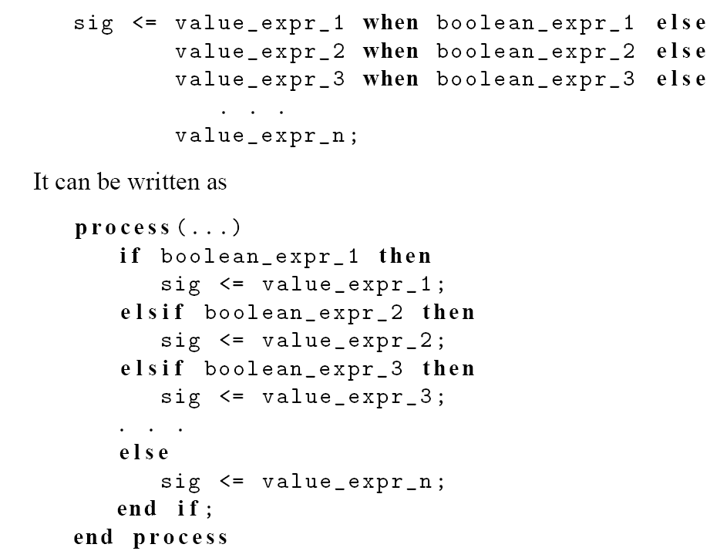
PUE 3141 Advanced Digital Systems Design

Slide 24
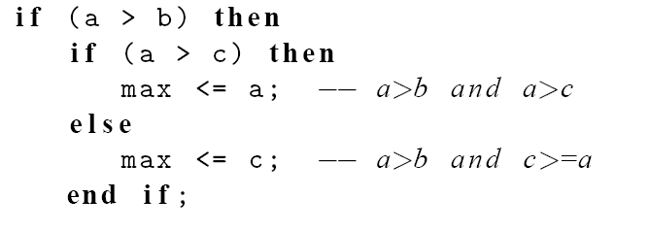
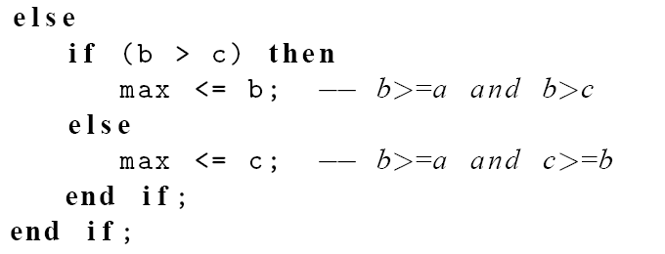
e.g., find the max of a, b, c
PUE 3141 Advanced Digital Systems Design

Slide 25
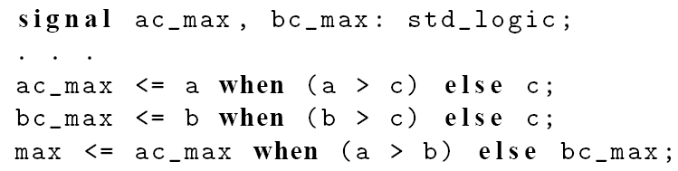
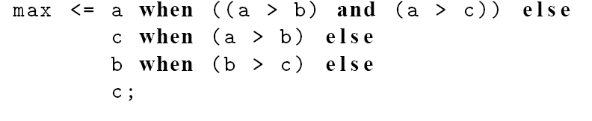
e.g., 2 conditional sig assignment codes
PUE 3141 Advanced Digital Systems Design

Slide 26
2 conditional sig assign implementations
PUE 3141 Advanced Digital Systems Design

Slide 27
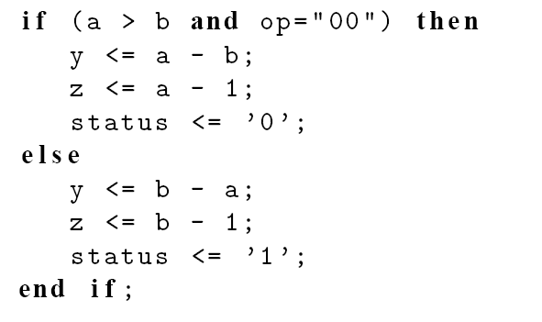
e.g., “sharing” boolean condition
PUE 3141 Advanced Digital Systems Design

Slide 28
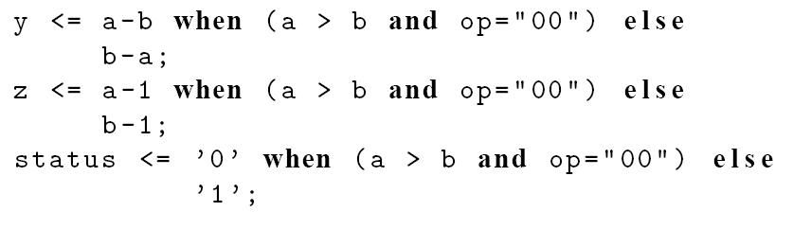
PUE 3141 Advanced Digital Systems Design

Slide 29
Incomplete branch and incomplete signal assignment
According to VHDL definition:
  Only the “then” branch is required; “elsif” and “else” branches are optional
  Signals do not need to be assigned in all branch
  When a signal is unassigned due to omission, it keeps the “previous value” (implying “memory”)
PUE 3141 Advanced Digital Systems Design

Slide 30
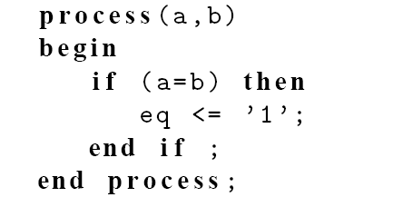
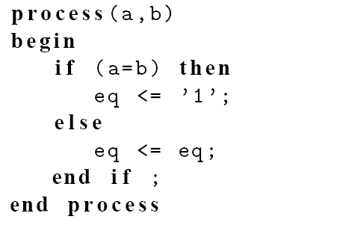
Incomplete branch
E.g.,
It implies
PUE 3141 Advanced Digital Systems Design

Slide 31
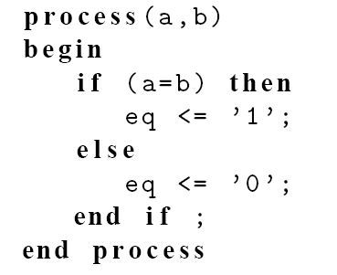
fix
PUE 3141 Advanced Digital Systems Design

Slide 32
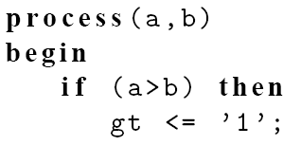
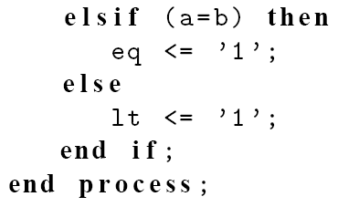
Incomplete signal assignment
E.g.,
PUE 3141 Advanced Digital Systems Design

Slide 33
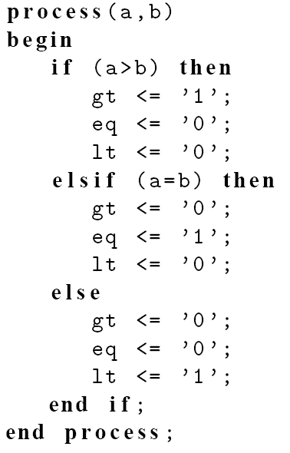
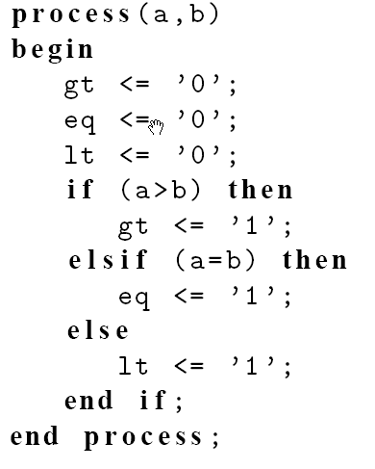
Fix #1:
Fix #2
PUE 3141 Advanced Digital Systems Design

